Slide 1
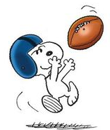
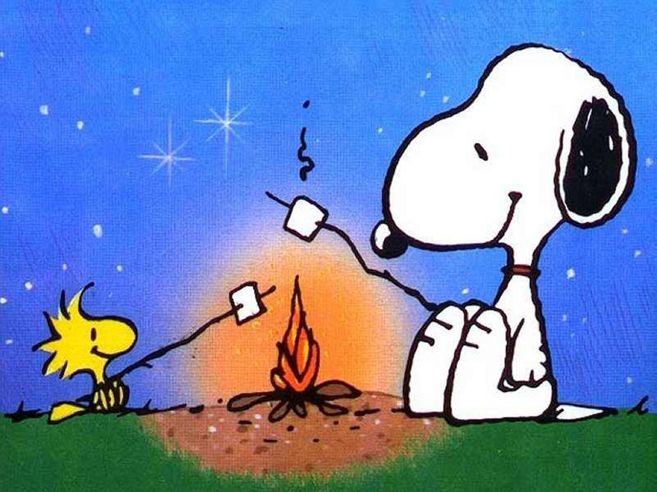
Grand Chapter Events at a Glance (As of 1 Nov 17)
Sat. Jan 20 East West Shrine Football Party, Union Grill, Ogden Pregame Party begins at 12:00p,
Kick-Off at 1:00p, Food, Drink & Games during the Game!!
Benefitting: Un-LIMB-ited Summer & Winter Camps for Teen Amputees, SL Shriners Hospital
Apr 21 Sat: Beaver Splash!, Ogden Masonic Temple Back Yard, More information as it becomes available, Event begins at 12:00
Benefitting: Northern Utah Wildlife Rehabilitation Center, Ogden, Utah
May 5 Sat: Third Annual Run for the Roses!, Green River, Ut, More information as it becomes
available, Event begins at 1:00p after Bethany’s GV
Benefitting: The Charities of the WGM & WGP
May 19 Sat:
Knock MS Out of the Park!, Ogden, Ut, More information as it becomes
available, Event begins TBD
Benefitting: The Utah Chapter of the National MS Society
May 31-June 4: Grand Chapter Trip to St Louis!, StL Cardinals at Busch Stadium (maybe twice!), Visit New Hope Chapter ### (Chapter of the WGMs mom & grandma) and more!
Aug 3-5: Campout and Hands Across the Border with NV!,
Somewhere in the Mountains

